Slide 1




iOS Tech Talk Crash Course in iOS Development
Nick Neuberger – Senior iOS Developer at Panera
Notes:
Hello all…. How is everyone doing at Tiger Hacks???!!!!
Who wants to learn iOS Development and have a crash course in iOS Development?

Slide 2
Are you READY for this??!!!!
Ready for iOS Development?
Notes:
Are you guys ready for the FIRST ever Tiger Hacks event?
How many people do we have here?
Tech Talks all about iOS Development? I’m here to talk you into iOS Development for your hack.
Ready to have fun? After my info packed tech talk, you’ll be a Mobile developer for Life. And for Apple.. ☺
I’m here to lock you into the Matrix, we call Apple Lockdown?. Just say no to Android…and say yes to iOS Development. Ok just kidding…

Slide 3
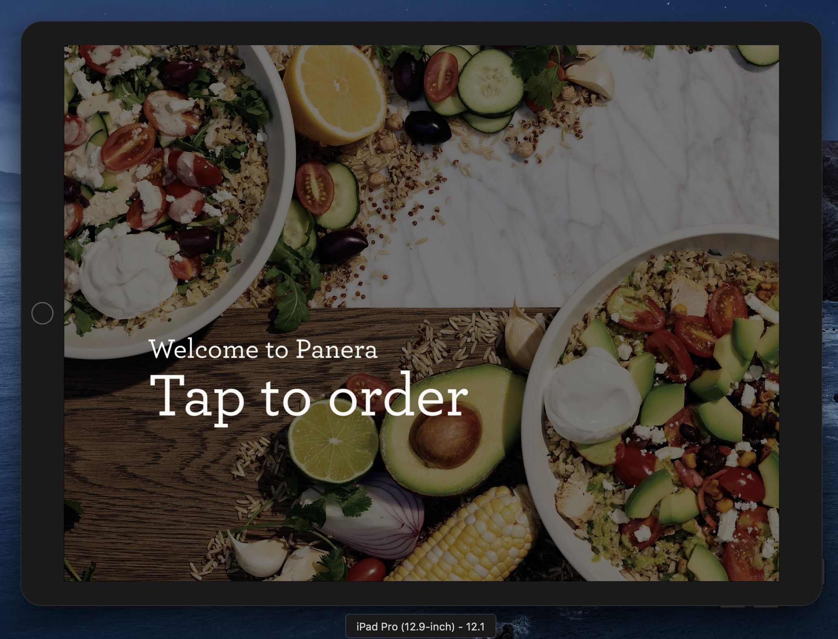
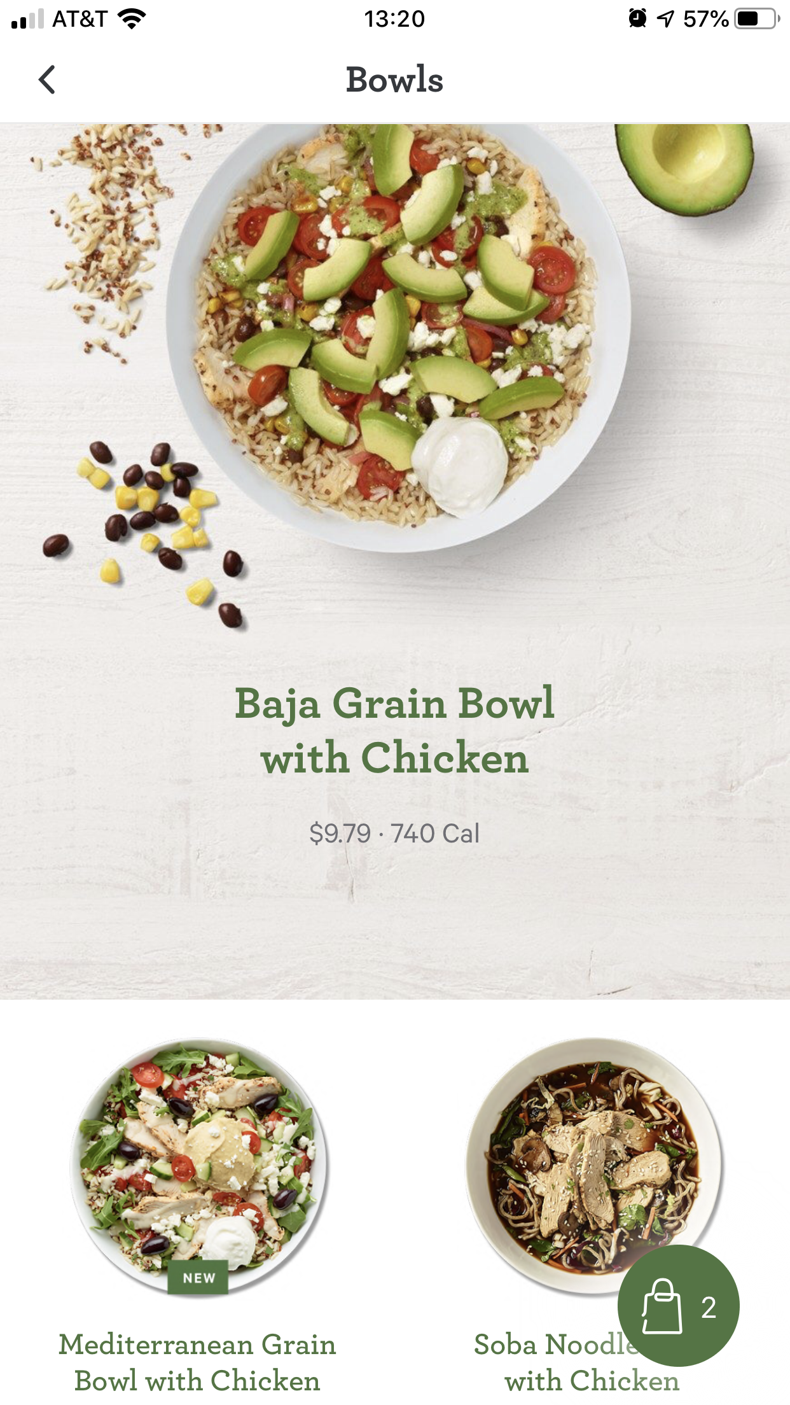
About Me
Senior iOS Developer at Panera on Native Apps Team
25 yrs of programming
8+ yrs with iOS and Android development with Swift, ObjC, Java
Worked at big and small firms in STL area
AWS: IoT Core (Internet of Things) and DynamoDB
Built ~8 mobile applications (Restaurant, Boating, Aviation, Government industries)
10+ yrs Java stack, Spring MVC, Spring Boot, Oracle
Visual Basic, MS SQL Server, Access #oldSchool
https://www.linkedin.com/in/nneuberger1/
Notes:
Panera 5.5+ years, Best Tech stack and latest tools
Vote Track, Panera, Total Hockey
Web Services, Front End Web UI

Slide 4


About Me
Married with 4 kids, 2 grand kids
Pilot’s License & YT Channel “Midwest Flying” – 15 subs….lol
HAM Radio License (what’s that?)
Learning Spanish
Side iOS projects
“Always Learning”
“Be Passionate”
“Don’t be an IT Dinosaur”
Notes:
Very important. Stay Passionate about something in IT.
If you don’t, you may become extinct like a Dinosaur in the IT world.

Slide 5

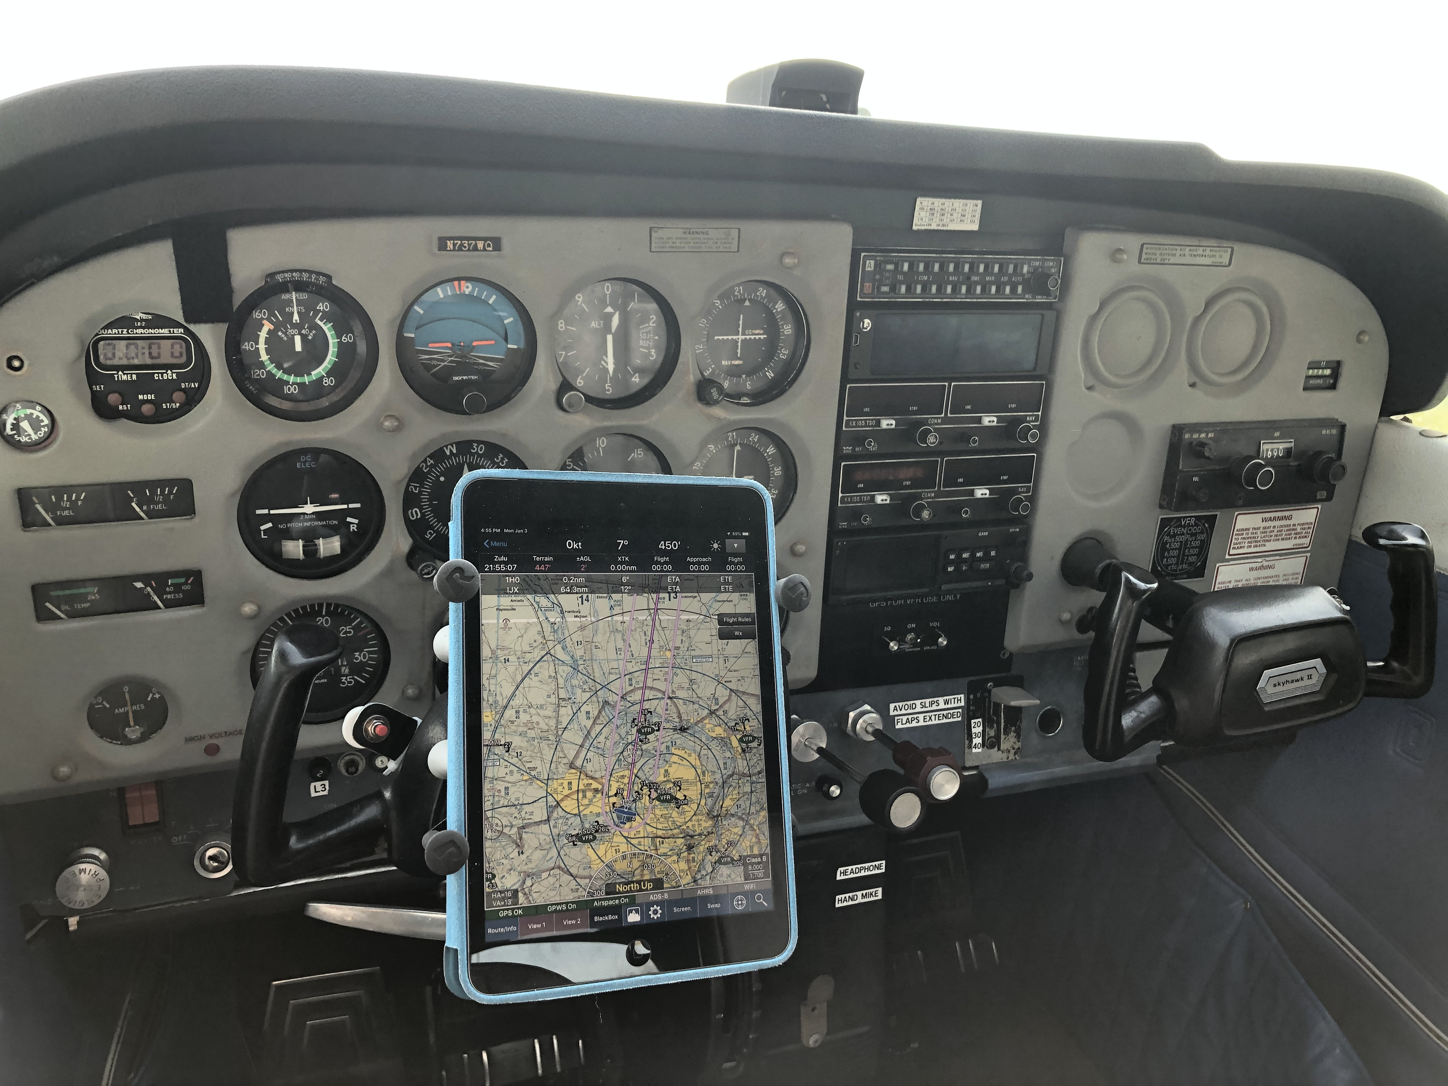
About Me
Notes:
Did I mention I love programming AND flying??!!??
The Demo Git Hub app is inspired by my passion for both programming and flying
Great Advice here…. Do what your passionate about and you’ll never feel like you’re working.

Slide 6
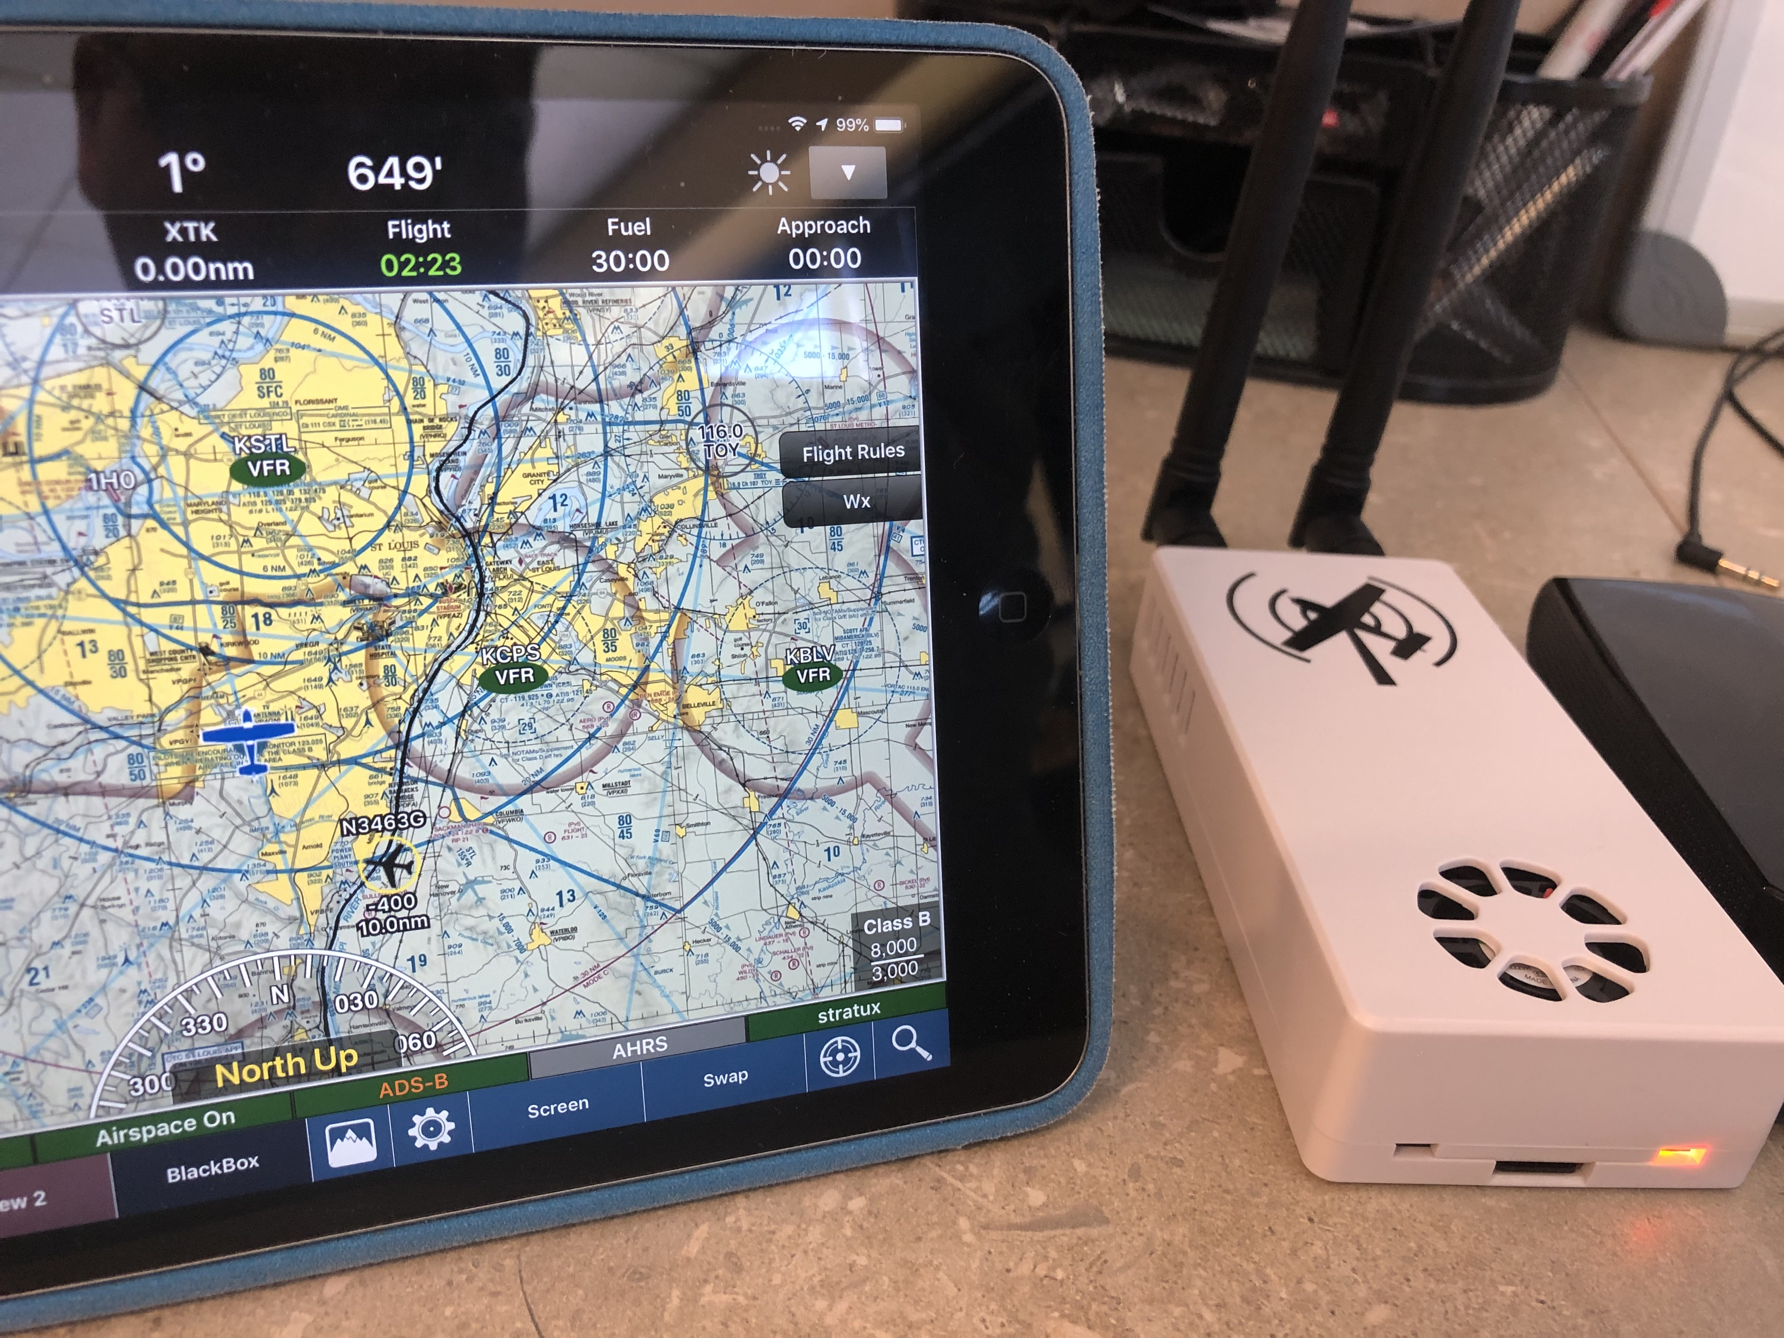
About Me – Raspberry Pi / Flying
Notes:
Here’s the Raspberry Pi I setup for flying.
Enough about me..

Slide 7
What you’re going to Learn in < 60 Minutes!
Learn about Me, iOS Development at Panera. Tricks of the Trade..
What you’ll need. The tools…. to help for your hack or career
Some stats on iOS / Swift and the market
Goods and Bad’s of iOS Development
Force unwraps. And why it’s BAD..
What’s an optional in Swift? And why it’s a pain.
What’s a guard let in Swift? And why it’s awesome!
How to make Web Service (WS) calls (Must in all apps)
JSON data using Codeable
Codeable - Also great for storing for reuse (offline type support)

Slide 8
What you’re going to Learn in < 60 Minutes!
How to build a List and Detail page in a Storyboard
Linked to the WS data
Segues between each screen
Storing data locally using simple UserDefaults storage using Codable
Can be used for offline mode and pre-loading of data
Pulling in a new CocoaPod tool you found
Learn about gitflow (advanced release management)
Learn about Fastlane (Easier deploys to the app store)

Slide 9
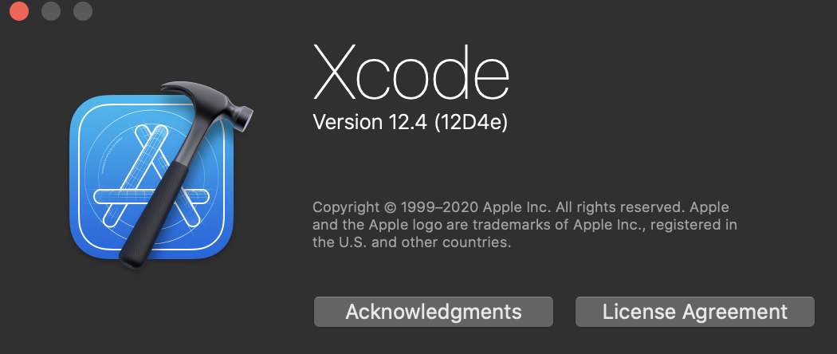
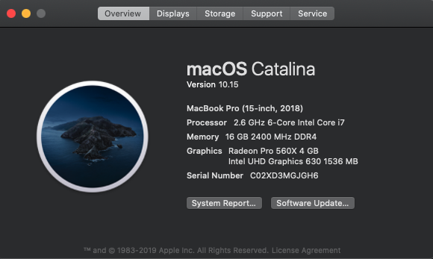

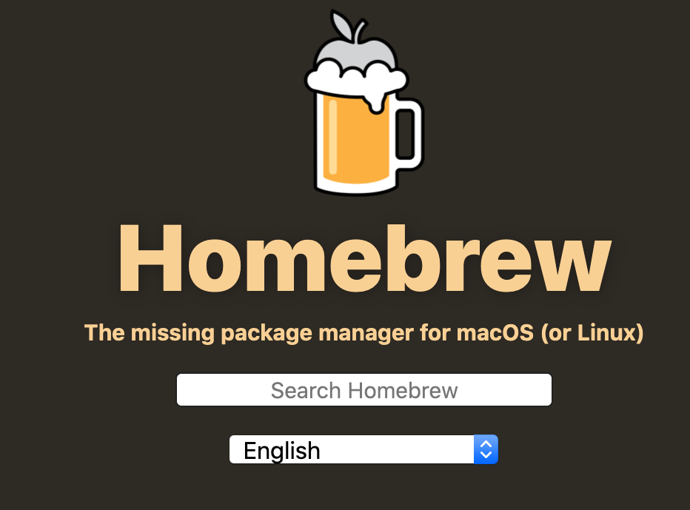
What you need….
Notes:
For development you will need a TON of tools depending on your project.
For the Git Hub project – Xcode 11.2
macOS (naturally)
Homebrew (quick downloads of command line tools)
CocoaPods (need some open source code to speed up your hack)

Slide 10






What you “might need”….
Notes:
For development you will need a TON of tools depending on your project.
Postman to make JSON based WS calls for development is a MUST have tool. Will show you that...
Sourcetree (visual git diffs)
Need Help fast? Get on the Discord channel....!!!
Charles - Totally necessary for iOS Development.. (Check Charles...ask Charles...what did Charles say...!!!)
Swifter Swift. Making Swift easier... or more Swifter...
Fastlane. Not really for hackathon, but excellent for rapid deployment to the app store.

Slide 11
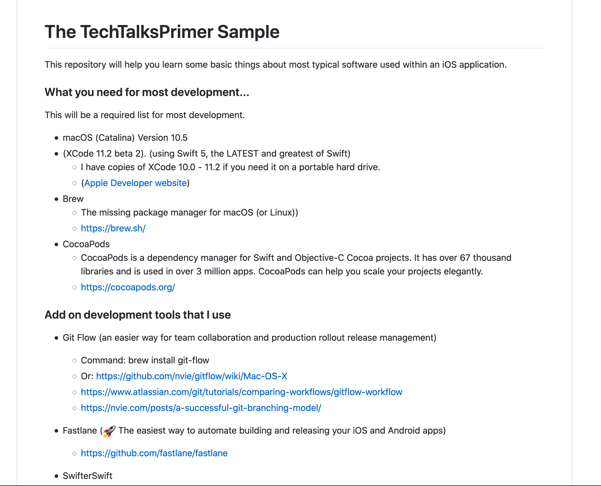

Go to my github sample app….
Fork the Code if needed
tinyurl.com/pickhacks-ios https://github.com/nneuberger1/TechTalksPrimer
Notes:
So REAL QUICK.. Go to my github.com page
Sample XCode app / Pods / Storyboards / Web Service calls
All the steps are on this page…
Examples of good AND bad programming examples
This sample application should help you speed things up a bit.
START DOWNLOADING XCODE 12.4 NOW….

Slide 12

Where are you at in this Journey??
Are you COMPLETELY new to iOS?
1 year of development?
3 years of iOS Development?
+5 years of iOS Development?
What about Objective C?
What about Swift?
Have you NOT decided yet?
Notes:
Are you completely new to iOS?
Focus on Swift for your hack. 1000s of examples.
Maybe after this you might consider Xcode and iOS Development

Slide 13
Why iOS Development??
~2.2 M apps on the app store!!
It’s easier now with Swift. ObjC boo….!
5th MAJOR release of Swift
English language, Not cryptic
Dependency Managers (67k libraries)
Build Tools (Fastlane, CI / CD)
Open Source
Server Side development
Swift UI (available in Xcode 11.2+)
https://github.com/apple/swift
Notes:
This tech talk focuses on Storyboards
I don’t go into details on Swift UI.

Slide 14
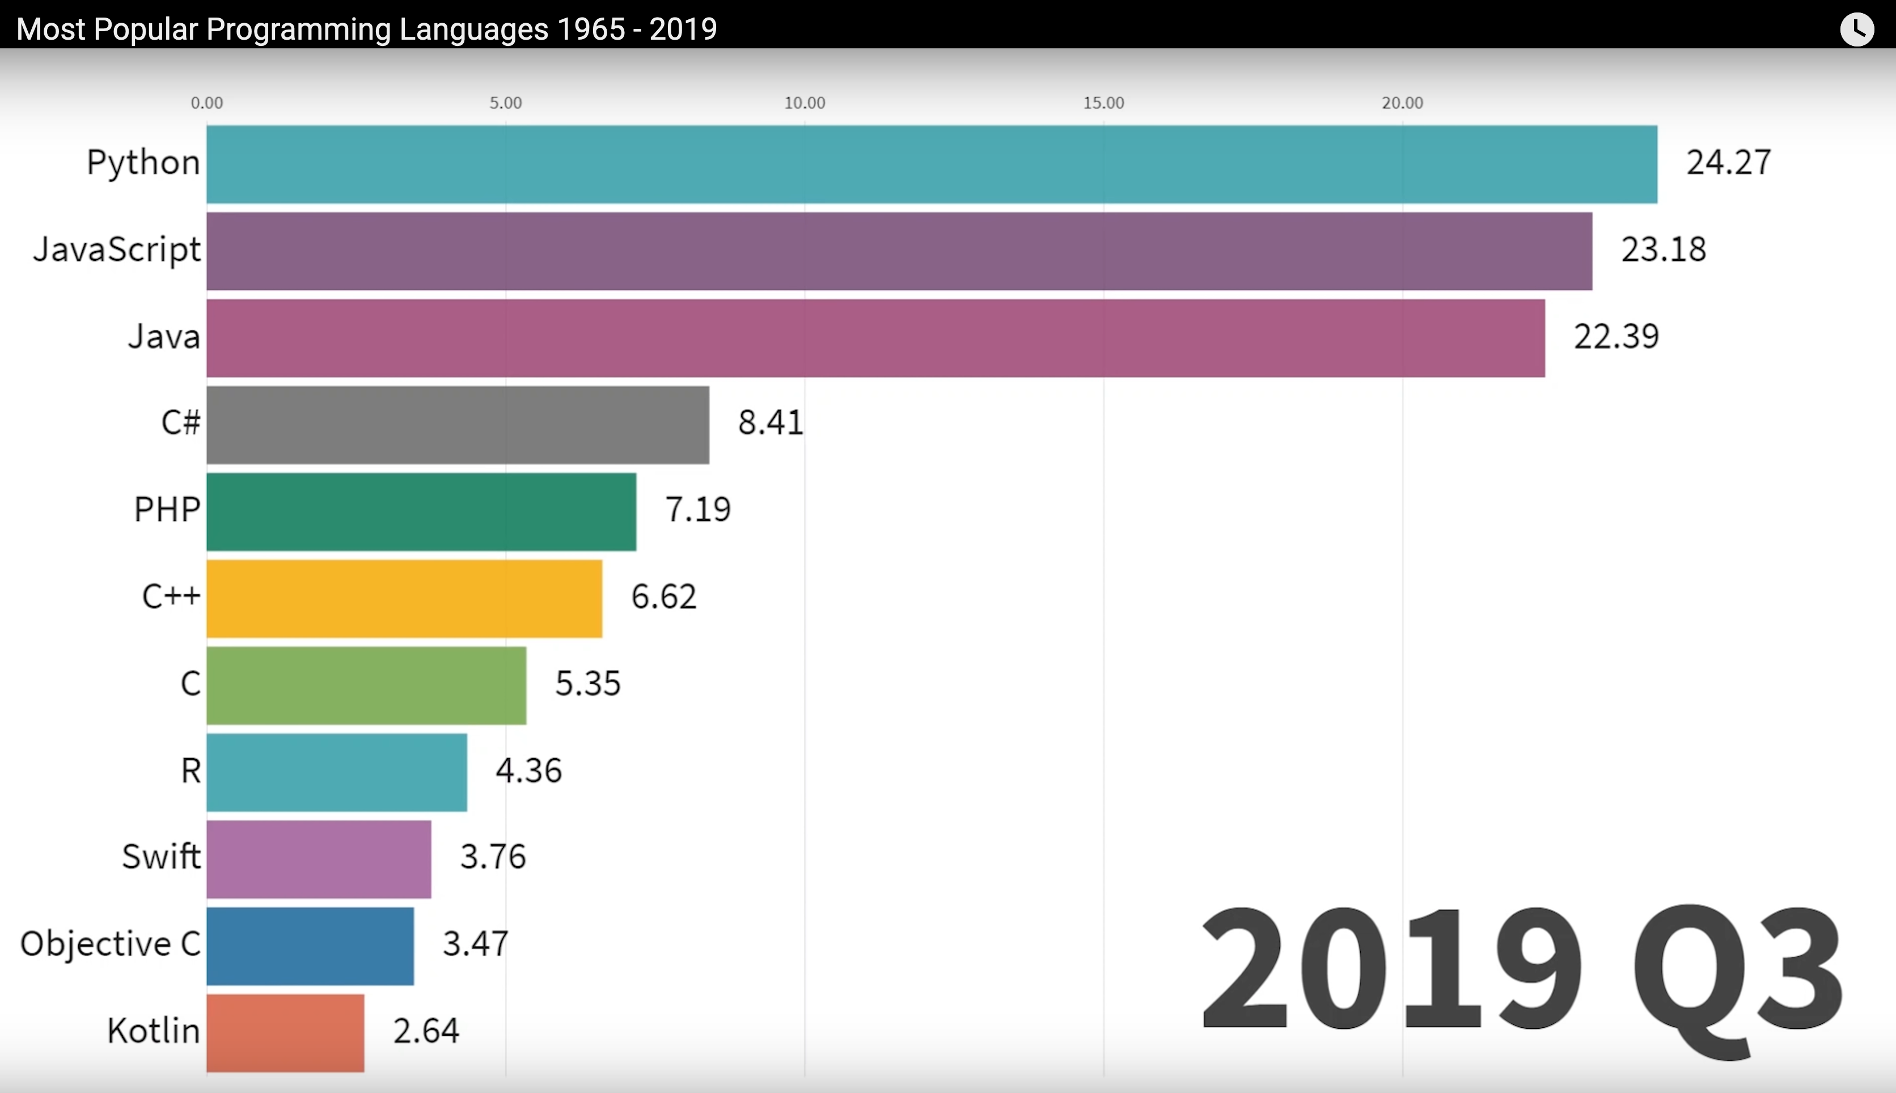
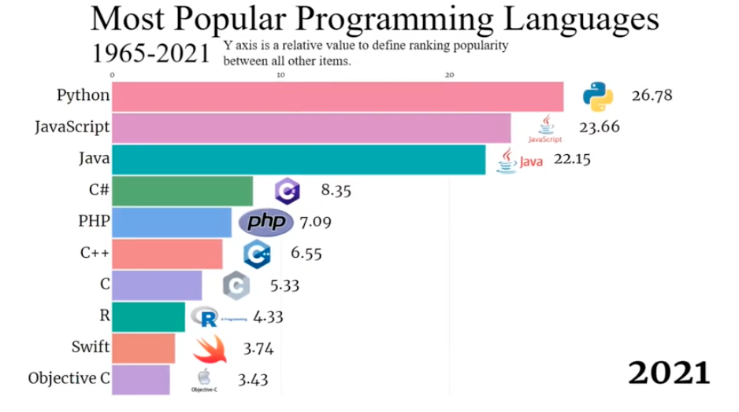
Why iOS Development
YT: Most Popular Programming Languages (1965-2021) https://www.youtube.com/watch?v=M0vBoBqqjr0
Notes:
Some stats on Swift
Where is Flutter and Dart?
I’m waiting to see how that works

Slide 15

Why iOS Development
Jobs…!!!
LinkedIn: 23, 000 Worldwide
5,000 US Market
Panera: Always looking for talent. Internships and full-time mobile positions are available throughout the year
Notes:
- If interested and have a resume or LinkedIn send me a Discord message.

Slide 16
About Panera IT
Yearly Hackathon’s
Pumpkin Carving contest
Segway Fun…
Yearly Demo ball events
CI / CD Pipelines (Continuous Integration / Continuous Deployments
Over 10 Million iOS Downloads
Mobile App ~Total Lines of Code (LOC)
Swift 126,183 (93%)
Objective-C: 8,616 (7%)
Total: 126,299
2 years since full ObjC code.. Ton’s of refactoring…
Notes:
Panera 5+ years, Best Tech stack and latest tools
Leaders in the Restaurant in Innovation – Bar None..

Slide 17
Quick Pointers for iOS Development

Slide 18
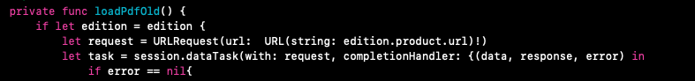


Force unwraps. And why it’s BAD..
Definition: Allows the developer to ”potentially” access an ”optional” when it “may not be there”. Did you hear that????
Don’t use them…. Almost NEVER.
There are rare cases when you can safely
They WILL lead to crashes
Maybe OK for a Hack-A-Thon… to quickly get something done..

Slide 19
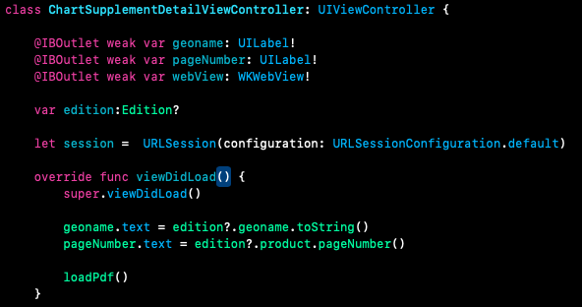
Optional’s in Swift
Definition: Allows a ”nillable” value for the variable
All callers must check for it before accessing the variable

Slide 20
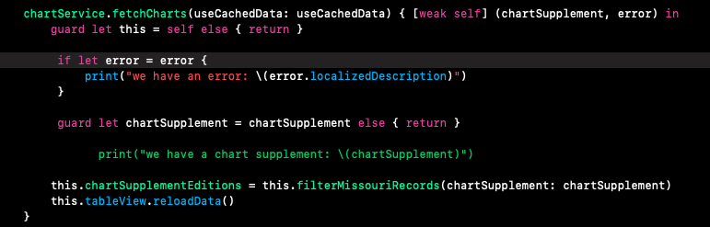
Optional’s in Swift
Use an if let to make sure the variable (that’s optional) is there.
Show examples of Structs (No optionals…, stateless)
Edition.swift
ChartSupplementDetailViewController.swift

Slide 21
Optional’s in Swift. And why it’s a pain..
Use an if let to make sure the variable (that’s optional) is there.
Seems like your always doing guard let’s OR if let’s
Try to minimize optional’s, but sometimes they’re absolutely necessary

Slide 22
Optional’s in Swift
Use an if let to make sure the variable (that’s optional) is there.

Slide 23
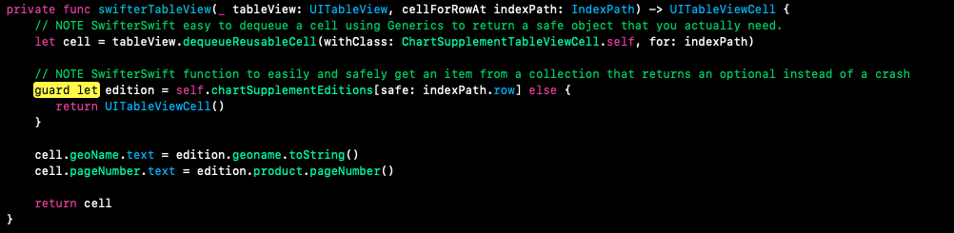
Guard lets and why it’s awesome
Use a ”guard let” for checking.
Easily allows guaranteed variables for “precheck” variables and easier “afterwards” program control.
I’m a huge fan of guard let’s. Easier to read.
Notes:
Java Dev for 10+ years and would have loved something like this for easier coding.

Slide 24

About the Sample iOS Application

Slide 25
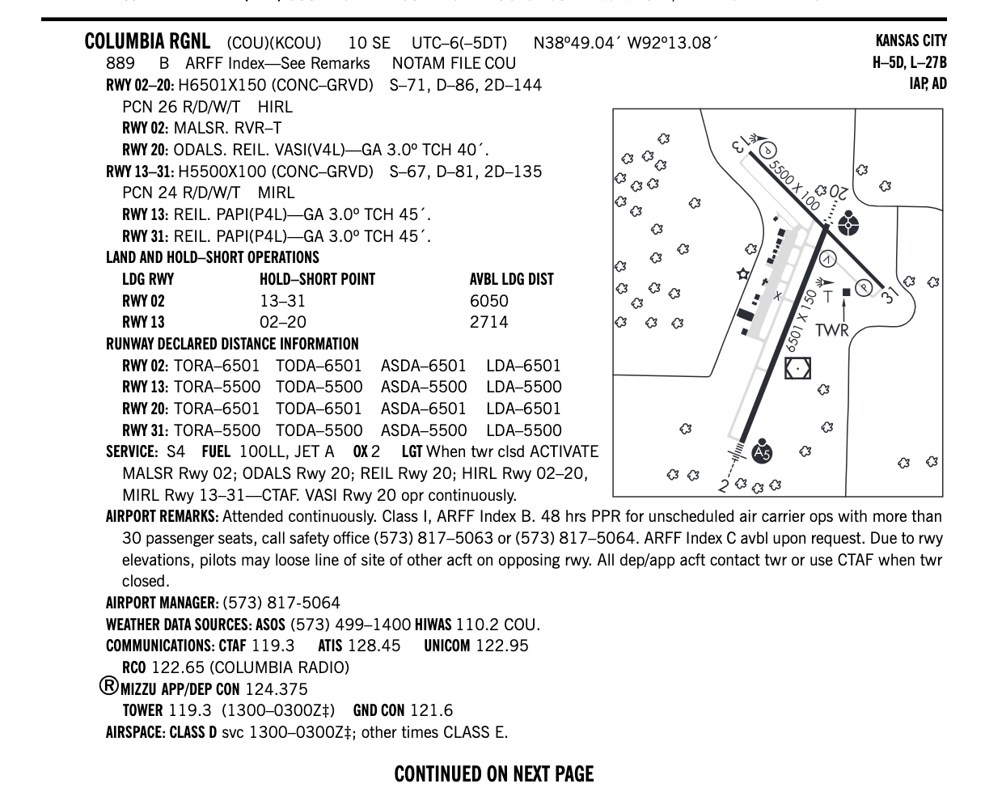
About the Sample iOS Application
Notes:
This is a page from the sectional chart that we will display on the screen coming from the web.

Slide 26
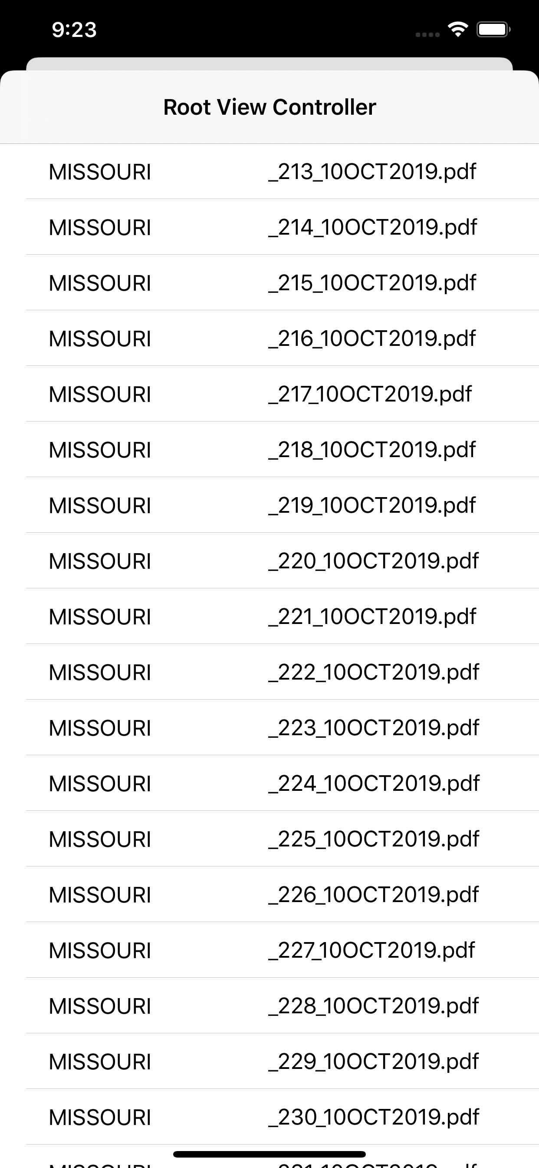
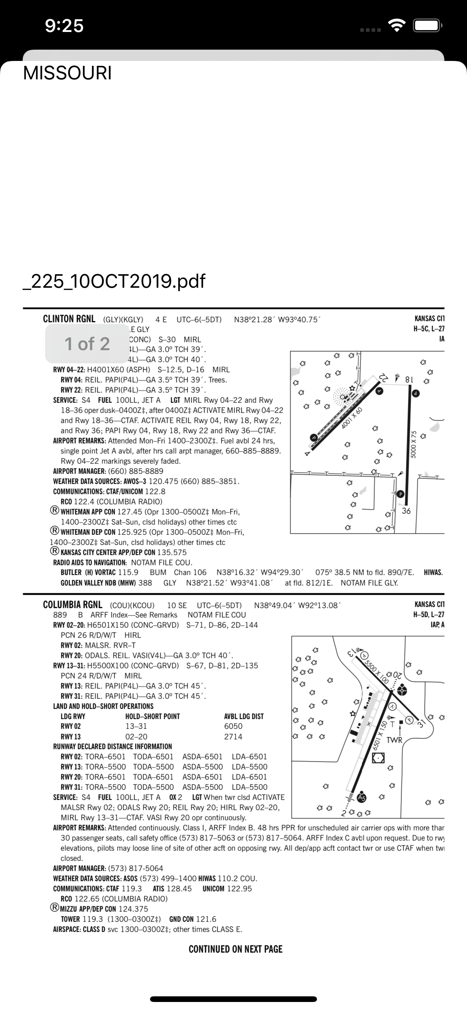
Sample App Demo Time
Notes:
Uses the details data that includes a URL with the PDF location
Show Postman call
Displayed on a Detail Page
Basic Concepts.
It’s UGLY.... By design…

Slide 27
Swifter Swift… what is it??
SwifterSwift is a collection of over 500 native Swift extensions, with handy methods, syntactic sugar, and performance improvements for wide range of primitive data types, UIKit and Cocoa classes.
Go to: https://swifterswift.com/
Example app is using it.. Search for “SwifterSwift” in the code
Notes:
Go to link
Show some features and screenshots
Show command line

Slide 28


How to make Web Service (WS) calls
We need to make a WS call.
https://github.com/Alamofire/Alamofire
We need to parse data coming back
Use quicktype for fast JSON to Swift prototypes
https://app.quicktype.io/
Use Postman for testing some JSON service calls
Notes:
Alamofire – Less boilerplate code, uses Enums for errors, requires less code, but you do need knowledge on their API.
Show POSTMAN call
Open quicktype.io paste in the response data

Slide 29
Need a CocoaPod dependency?
Why use cocoapods? Or open source libraries?
Xcode has upcoming swift package manager
Faster to market
Easier for the hack-a-thon. I’m sure you’ll need it..
Easy to integrate 3rd party libraries
Find a cocoa pod
Edit Podfile
Run at command line: pod install
Start integrating the code
Notes:
- Snapchat pod?
- Facebook Auth pod?
- Google libraries?

Slide 30
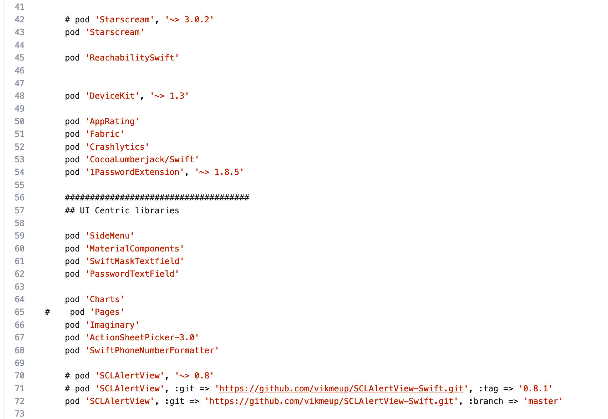
Example Podfile using several pods
Notes:
Shows TONS of Pods that I pulled in and immediately used inside an application
Saved time on the project and lowered costs for the client
Some clients want completely custom applications. Less need for Pods

Slide 31
Cocoapod Demo time…
We need a nice alert popup within the application
Go to: https://github.com/vikmeup/SCLAlertView-Swift
Use Git Flow for project work
git flow feature start alertView
Add to the Podfile
Run: pod install
Integrate the code…
Notes:
Go to link
Show some features and screenshots
Show command line

Slide 32
How to build a List and Detail page in a Storyboard
Show storyboard. Explain Segue’s to link pages.
Auto Layout. Let’s fix some layout issues
Loading Data onto the List
Filter the Data
Transition Data to the Detail page
Let’s take a look… Demo time…

Slide 33
Storing data locally using UserDefaults.
Advantages of storing data
Offline Mode / Bad network connections
Alternative to SQL Lite type solutions. Easy implementation
Less boiler plate to standard iOS native functions
NEW – Uses Codable
OLD School Ways were horrible
Every single attribute was maintained. See NSCoding
DEMO TIME

Slide 34
Extra Developer Tools
Notes:
Git Flow
Fastlane

Slide 35
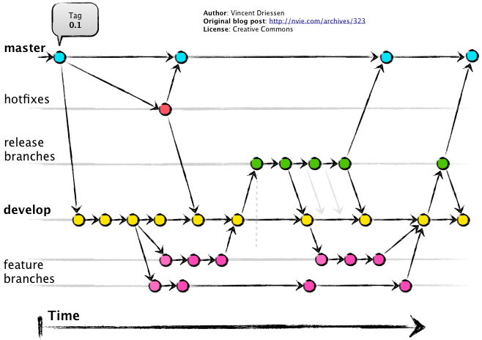
Git flow
Awesome streamline of all work flows for development with Git
Eases the pain of determining where to branch from
What branch do I branch from?
What branch do I merge to?
Oh, I forgot to merge my code into “master” and/or“develop”
I’ll show you some examples..

Slide 36
Git flow

Slide 37
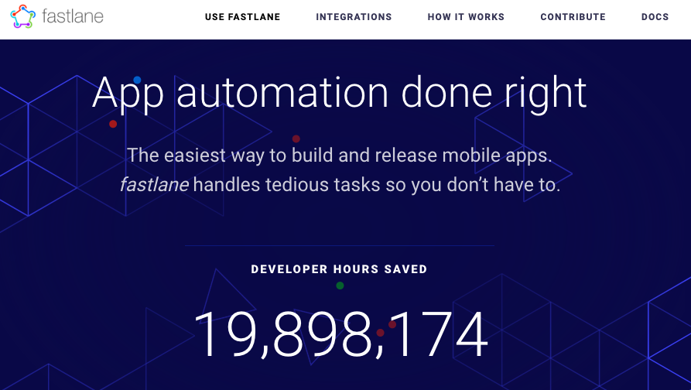
Fastlane (what is it…??)
https://fastlane.tools/
Notes:
Go to link: https://fastlane.tools/
Show some features and screenshots
“I use Fastlane for ALL of my side applications”
Configuration Based / Eliminates custom scripts for builds, testing, deploy to app stores.

Slide 38
Q & A Session??
Notes:
Any questions?
Need Help?
Need the SnapChat API integrated?
Help with iOS Provisioning?

Slide 39



Thank you and Good Luck!
Give iOS Development a try..
If you need help ask….!
I’ll be on Discord for Q&A
That’s it…. Go Pick Hacks!!!
Notes:
Help: Ask us any question..
Gadgets: Camera Recognition AWS Deep Lens Camera, Segways, Spectrometer, Raspberry Pi for Flying

